Slide 1

Introduction to Jenkins
Module 3: Jenkins Jobs and Pipeline-as-Code

Slide 2
Topics
Freestyle vs. Pipeline Jobs
Declarative Pipeline basics
Scripted vs Declarative Pipeline
Pipeline libraries and shared steps

Slide 3
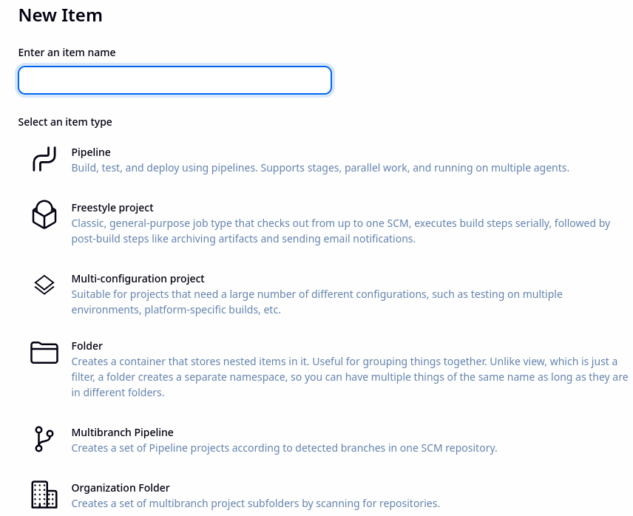
Jenkins Jobs
A Jenkins job defines:
  What Jenkins should do
  When it should run
  Where it should run
Jenkins supports multiple job types
Two basic types
  Freestyle jobs
  Pipeline jobs

Slide 4
Freestyle Jobs
This is the legacy model
Configured entirely through the Jenkins UI
Step-by-step build actions
  Easy to start with
  Hard to scale and maintain
Typical Use
  Simple builds
  Older Jenkins installations
  One-off tasks

Slide 5
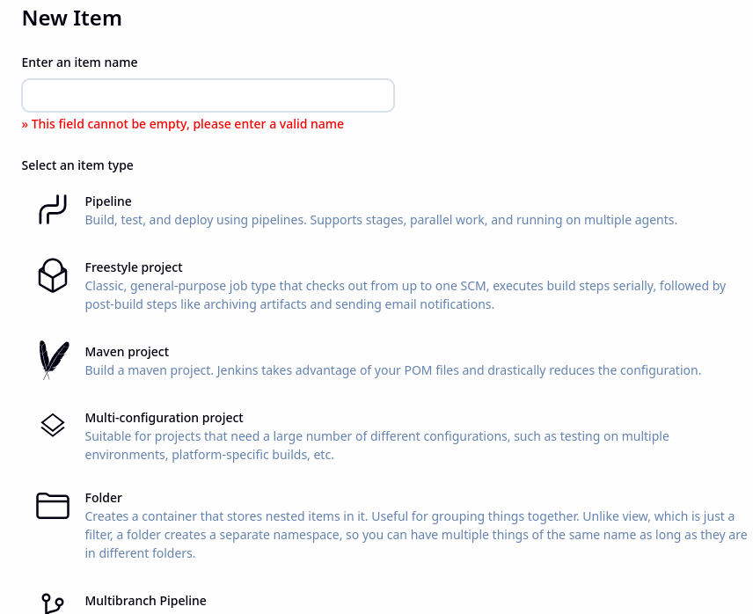
Freestyle Jobs
Plugins extend functionality
  Usually associated with a specific tool
    For example, Maven
  Adds additional configuration options for that type of project that are needed for the tool
  For example, the POM.xml file to use in a Maven project

Slide 6
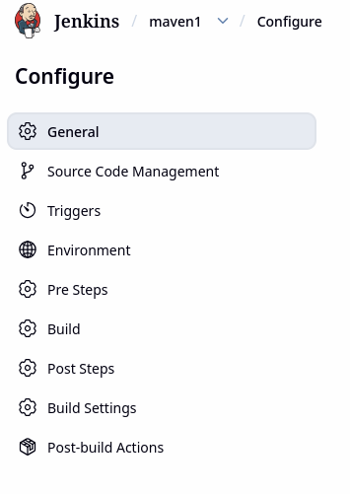
Freestyle Jobs
Limitations
  Configuration lives only in Jenkins
  Hard to version-control
  Poor support for complex workflows
  Difficult to review changes
Conflicts with IaC and DevOps principles
Freestyle jobs are easy to create but hard to manage

Slide 7
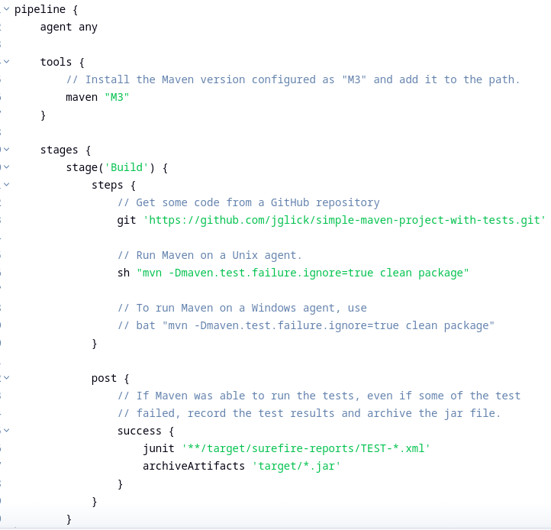
Pipeline Jobs
Modern Model
Defined as code
  Stored in source control
  Written in Groovy-based syntax
  Supports complex workflows
Benefits
  Version-controlled
  Reviewable
  Reproducible
  Scalable
  Better security and governance
Move Jenkins from a UI tool into a programmable automation engine

Slide 8
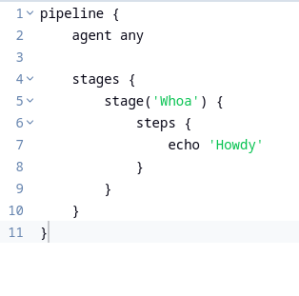
Declarative Pipeline Basics
A pipeline is:
A sequence of stages
  The stages are can be freely defined
  Executed on one or more agents
  Defined as code
  Managed by Jenkins
Pipeline stages usually describe
  Build
  Test
  Package
  Deploy workflows

Slide 9
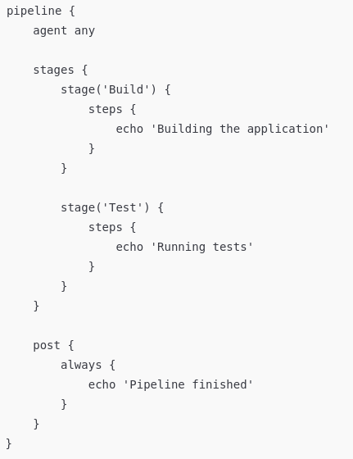
Declarative Pipeline Basics
Core declarative pipeline concepts
  pipeline {} – root block
  agent – where the pipeline runs
  stages – logical phases
  steps – actions inside stages
  post – actions after execution
Enforce structure and consistency
  Compile to Groovy scripts

Slide 10
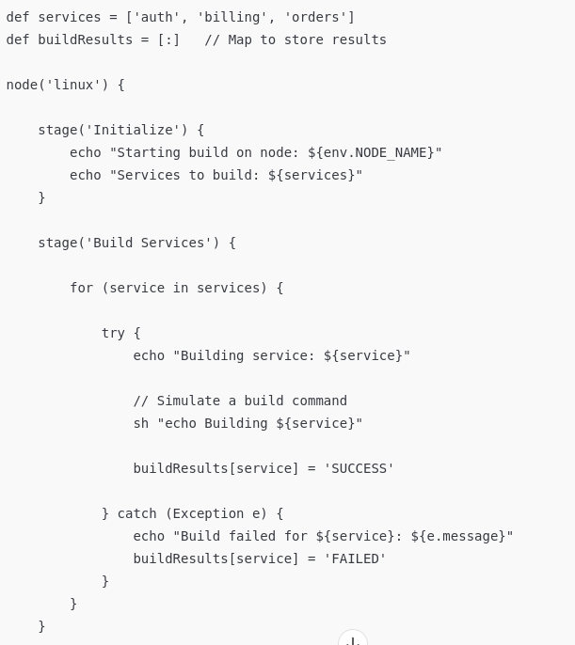
Scripted Pipelines
Both pipeline types use Groovy
  The difference is the programming model and rules that Jenkins enforces
Scripted Pipeline
  Are written as Groovy scripts
  Gives full control of flow and logic
  Like a general-purpose program

Slide 11
Scripted Pipelines
Characteristics
  Very flexible
  Imperative style (“do this, then that”)
  Few guardrails
  Easy to shoot yourself in the foot
Scripted pipelines are used for
  Complex dynamic behavior
  Advanced logic
  Custom orchestration
  Legacy pipelines

Slide 12
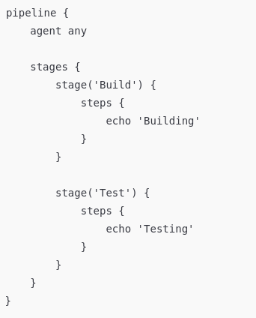
Declarative Pipelines
Characteristics
  Follow a defined structure
  Use a constrained syntax
  Are validated by Jenkins before running
  Opinionated
  Safer
  More readable
  Easier to standardize
  Built-in best practices

Slide 13
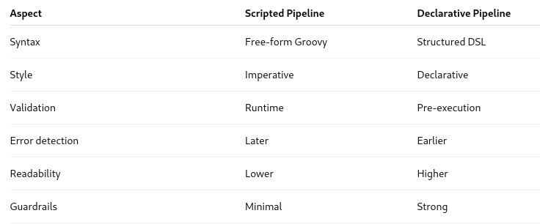
Comparison
Declarative pipelines describe what should happen
Scripted pipelines describe how it happens

Slide 14
Safety and Governance
Scripted pipelines
  Can run arbitrary Groovy
  Can access Jenkins internals
  Higher security risk
  Harder to audit
Declarative pipelines
  Restricted execution model
  Safer sandboxing
  Easier to govern
  Better suited for enterprises

Slide 15
Reason for Declarative Pipelines
Scripted pipelines came first but users ran into issues when using them
  Inconsistent pipelines
  Hard-to-read logic
  Security concerns
  Difficult onboarding
  Harder UI visualization
Declarative pipelines were introduced to
  Standardize structure
  Improve safety
  Make pipelines more readable
  Enable features like:
    post
    options
    environment
    when

Slide 16
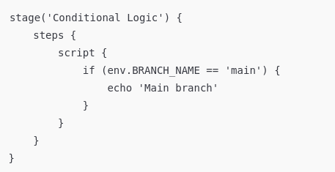
Mixing the Two
Declarative pipelines can include scripted logic inside script {} blocks
This gives
  Declarative structure
  Scripted flexibility where needed
  Best practice
    Declarative pipeline + small scripted sections.
Declarative pipelines are the recommended default
Scripted pipelines are a tool for advanced cases

Slide 17
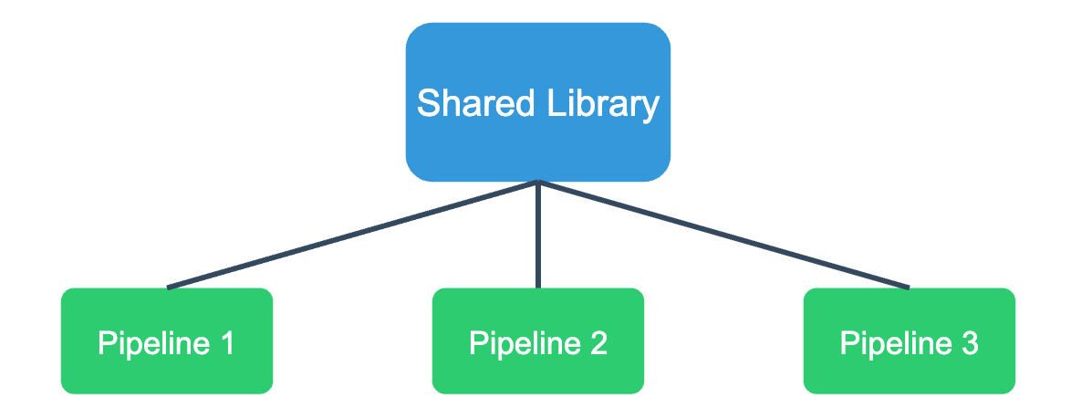
Pipeline Libraries and Shared Steps
A shared library is
  A separate Git repository
  Containing reusable pipeline code
  Loaded dynamically by Jenkins
  Used across many pipelines
Shared libraries allow teams to
  Reuse logic
  Standardize behavior
  Reduce duplication
  Centralize best practices

Slide 18
Typical Content
Common functionality in shared libraries
  Build logic (Maven, Gradle, npm)
  Test execution
  Code quality checks
  Security scans
  Artifact publishing
  Deployment logic
  Notification handling
  Error handling and retries

Slide 19
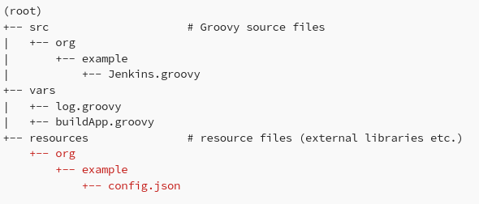
Architecture
Libraries contain only groovy code
They do not contain declarative scripting code
  Declarative scripts provide a pipeline structure
  Not appropriate for callable functionality in the library
  Have a standardized structure
Jenkins knows how to load them

Slide 20
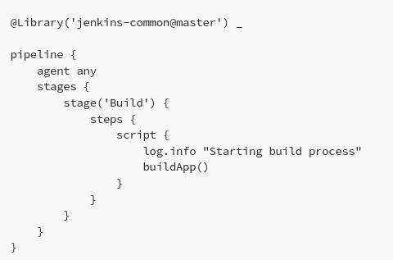
Using Libraries
In the example
  The “jenkins-common” library is imported using the @Library annotation
  The _ (underscore) at the end is necessary when not immediately referencing a class from the library
  The functions defined in the shared library, such as log.info and buildApp() can now be used

Slide 21
Shared Steps
Shared steps are:
  Reusable functions
  Written in Groovy
  Exposed to pipelines as simple method calls
  Instead of writing complex logic in every Jenkinsfile, pipelines just call a shared step
    RunTests()
    BuildArtifact()
    deployToEnv('prod')
  The actual implementation is defined in the shared library.

Slide 22

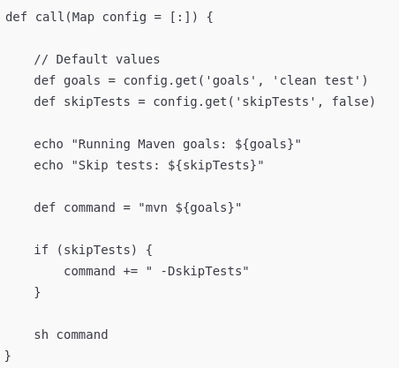
Shared Step Example
The shared step code is stored in the vars directory
  Anything under vars/ becomes a callable step in a Jenkinsfile

Slide 23
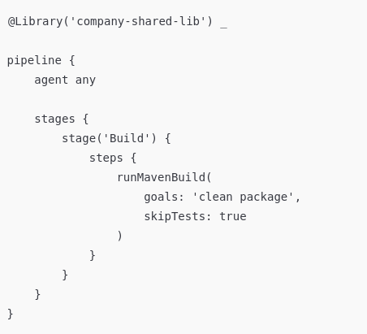
Shared Step Example
The code example shows using the step code in a pipeline
At runtime
  Jenkins loads the shared library
  Finds vars/runMavenBuild.groovy
  Exposes call() as runMavenBuild()
  Executes the Groovy code on the agent
Usage
  call() makes the step feel “built-in”
  Parameters allow customization
  Logic lives in one place
  Changes affect all pipelines consistently

Slide 24
Shared Step Example
The code example shows using the step code in a pipeline
At runtime
  Jenkins loads the shared library
  Finds vars/runMavenBuild.groovy
  Exposes call() as runMavenBuild()
  Executes the Groovy code on the agent
Usage
  call() makes the step feel “built-in”
  Parameters allow customization
  Logic lives in one place
  Changes affect all pipelines consistently

Slide 25
Questions

